Slide 1
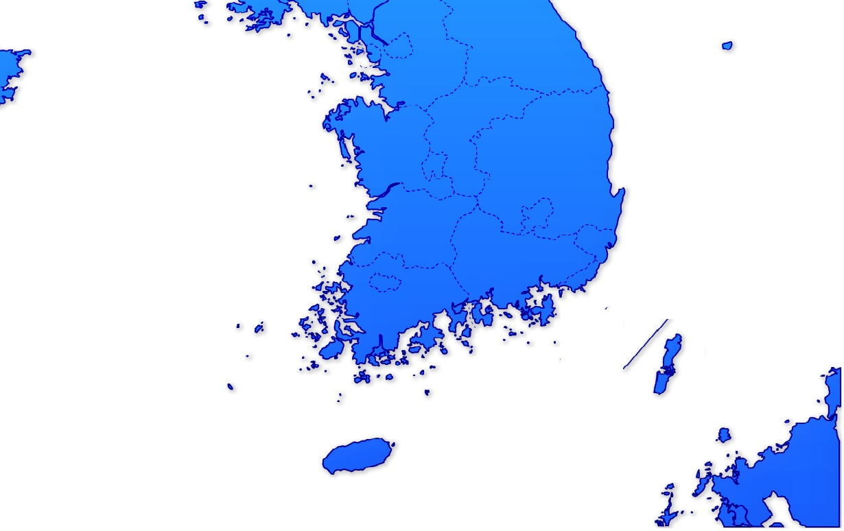
SOUTH KOREA
Arranging Vessel Drydock & Repair Consulting
New Building Consultant
Korea Marine Product sales
Mtide Engineering & Trading Pte Ltd
120 Lower Delta Road # 12-12 Cendex Centre Singapore 169208
Tel : +(65)6396 5474 Fax: +(65)6396 5472 Mail : operation@mtide.com.sg
PIC : Mr. Greg Kim Y. B. / Mr. Peter Ha Y. H.
Singapore Mobile : +65 9752 1034
Mtide Korea Co., Ltd.
Rm 907 Hyoryeong Bldg, #1, Mugyo-dong, Jung-gu, Korea (100-170)
Tel : +(82) 2-738-5157 Fax: +(82) 2-738-5171 Mail : operation@mtide.com.sg
PIC : Mr. Greg Kim Y. B. / Mr. Peter Ha Y. H.
Korea Mobile : +82 10 5094 3880

Slide 2
Repair/New Building Shipyard in Korea
Dalian, China
Dalian DaeYang Shipyard
Incheon
Samkwang Shipyard
Ulsan
Hyundai Mipo Shipyard
Sekwang Heavy Industries
Mokpo
Mokpo Heavy Industry
Dae Bul Shipyard
Busan
Oriental Shipyard
Kangnam Shipyard
Mokpo
Green Shipyard
( Yacht, Pilot boat )
Tong Young
21C Shipyard
Yu Su
YS Shipyard
Mtide Engineering & Trading Pte Ltd
120 Lower Delta Road # 12-12 Cendex Centre Singapore 169208
Tel : +(65) 6396 5474 Fax: +(65) 6396 5472 Mail : operation@mtide.com.sg
PIC : Mr. Greg Kim Y. B. / Mr. Peter Ha Y. H.
Singapore Mobile : +65 9752 1034
Korea Mobile : +82 10 5094 3880

Slide 3
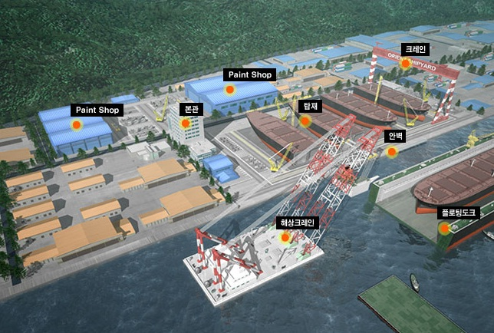
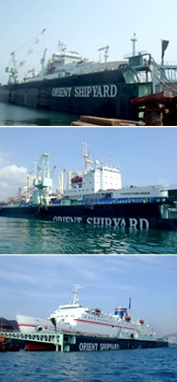
Repair/New Building Shipyard in Korea
Busan
Orient Shipyard

Slide 4
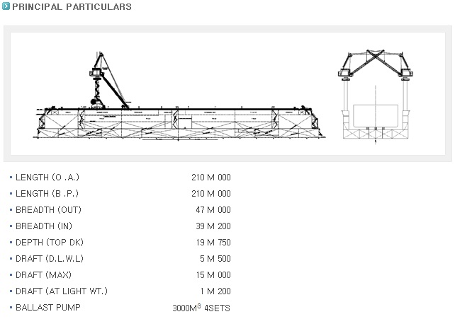
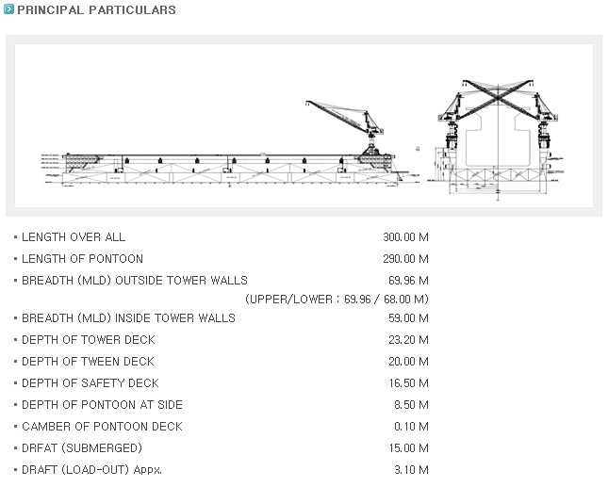
Repair/New Building Shipyard in Korea
Busan
Orient Shipyard

Slide 5
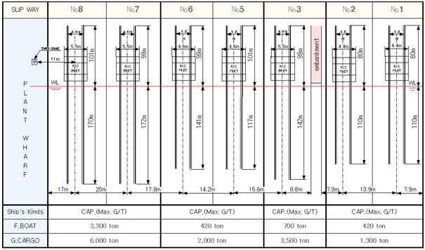
Repair/New Building Shipyard in Korea
Busan
Kang Nam Shipyard

Slide 6
Repair/New Building Shipyard in Korea
Ulsan
Hyundai Mipo Shipyard

Slide 7
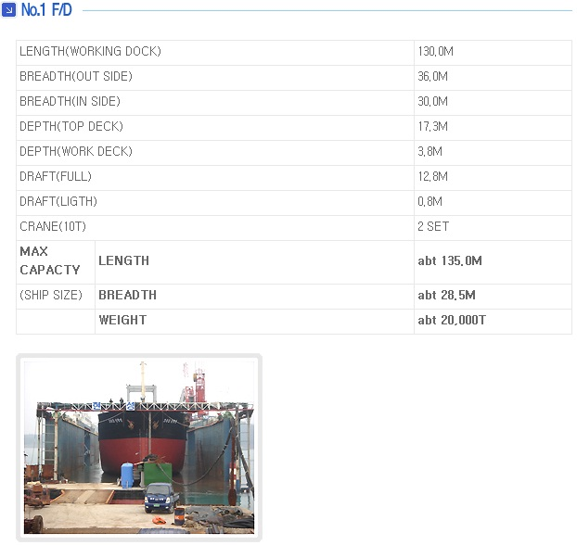
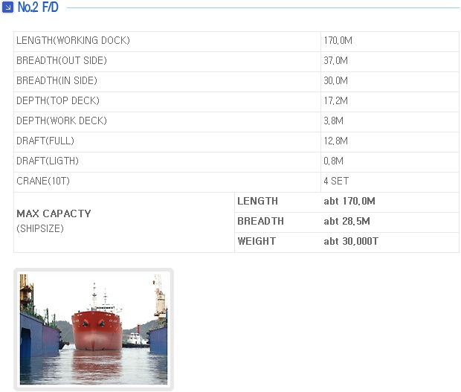
Repair/New Building Shipyard in Korea
Mokpo
Hyun Sung

Slide 8
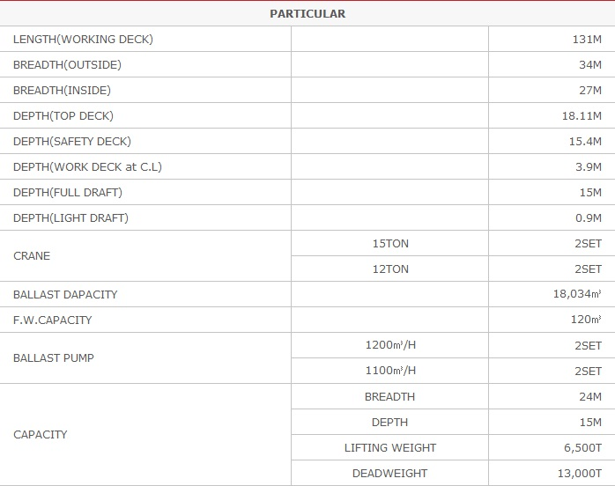
Repair/New Building Shipyard in Korea
Mokpo
Dae bul Shipyard

Slide 9
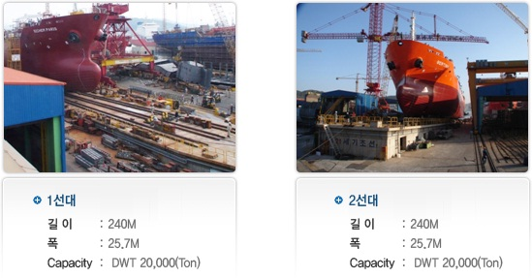
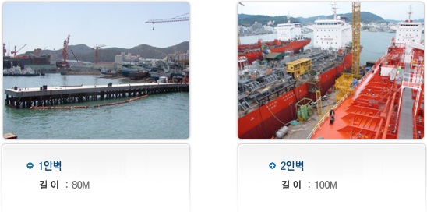
Repair/New Building Shipyard in Korea
Tong Young
21C Shipyard

Slide 10
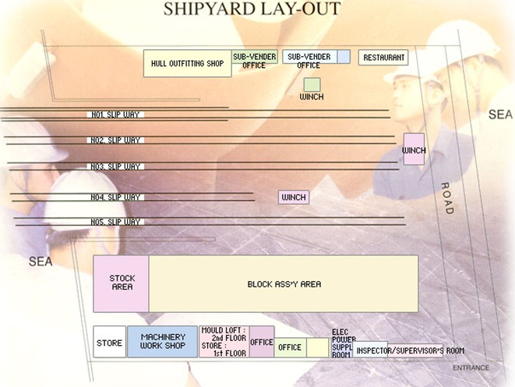
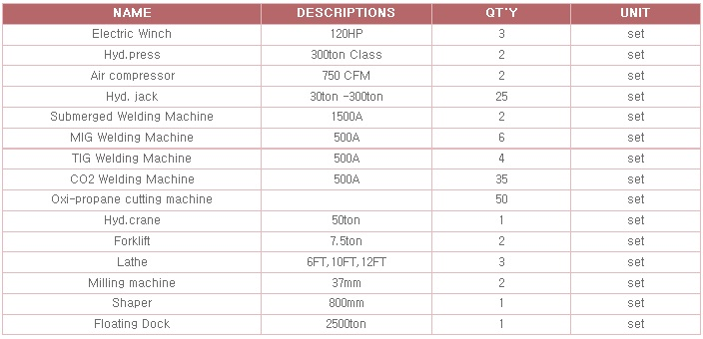
Repair/New Building Shipyard in Korea
Incheon
Samkwang Shipyard

Slide 11
Repair/New Building Shipyard in China
Dalian, China
Daeyang Shipyard
- VLCC, LNG, Cape Size/Panamax Size/Handy Size Bulk Carrier

Slide 12
Mtide Engineering & Trading Pte Ltd SUBSIDIARY OF MOSESTIDE PTE LTD
Repair track Record - 1
2006 February Incorporated in Singapore
2007 February STX Shipyard Guarantee Job – Repair for bow thruster in port (Pasirpanjang)
2007 May Daewoo Logistics (MT TRUST HONOUR) – Renew anchor & chain in anchorage
2007 August TB Sandy Pearl – Docking & Repairing in S’pore
2007 August MT ULAN SARI – Repairing for Rudder & Steering System
2007 October MT DL IRIS – Repairing for M/E & Pump , Motor
2007 November MV Daebo Frontier – Install & Modification for Ventilate Fan on Em’cy G/E RM
2007 December MV NO.3 SMILE – Install & Modification for Co2 Alarm system & panel
2008 February MV PETRA TRAVESSER – Spooling Job – 64mm x 330mtr
2008 May Hyundai Samho Heavy Industries – Repair for the fuel tank in S’pore anchorage
2008 May DL DL CALLA) – Docking & Repairing in Singapore
2008 September M/V BIKAN – Repairing for grab system & replace it.
2008 September YM 88 – Repairing for Motor & Panel Circuit board

Slide 13
Mtide Engineering & Trading Pte Ltd SUBSIDIARY OF MOSESTIDE PTE LTD
Repair track Record - 2
2008 October M/V Golden Express – Doppler & Speed Log Repairing in S’pore
2008 Octtober M/V Golden Express – Repairing for M/E Aux’ Blower System
2009 February M/V Hazel Ace – Renew fire damper & repairing in S’pore anchorage
2009 March M/V Dongbang Giant No.1 – Repairing for ballast tank crack in Thailand
2009 April M/V Voyarger V – Repairing & Modification Whole System in S’pore.
2009 April STX Shipyard Guarantee Job – Repairing for deck frame crack
2009 June M/V Dongbang Giant No.1 - Docking & Repair in Thailand
2009 July M/V Jonathan Ace – Repairing & Delivery in S’pore ST Marine Shipyard
2009 September YTC HERA – Renew & Install the hyd’ pipe line in BWT at OPL
2010 Jan MV SEA OF FUTURE – Docking & Repair in Singapore
2010 June MV Golden Brilliance – Docking & Repair in Korea
2010 July MV SUNNY PRIDE – Docking & Repair in Singapore
2010 July MV FORTUNE TRADER – Docking & Repair in Singapore

Slide 14
Korea marine product sales in S’pore
Mtide Engineering & Trading Pte Ltd SUBSIDIARY OF MOSESTIDE PTE LTD
Wire rope
Deck Crane - Marine Crane - Floating Crane ( 60/68Ton Crane ) - Gantry Typed Deck Crane - Offshore Crane - Davit - Special Crane - Deck Machinery
All size & kind of valve

